Slide 1
Wooden Cabinets and Vanities from China Inv. Nos. 701-TA-620 and 731-TA-1445
Presentation of the Domestic Industry
February 20, 2020

Slide 2
Introduction
The prehearing report demonstrates that imports of wooden cabinets and vanities from China are materially injuring, and threaten, the domestic industry
Subject imports increased by 54 percent during the POI, reaching about 21.6 million cabinets and $1.6 billion in 2018
U.S. demand is strong and growing, but Chinese imports are taking market share at the direct expense of the domestic industry
Chinese imports consistently undersell domestic products
Domestic producers’ financial performance has declined significantly

Slide 3
Single Domestic Like Product Coextensive With the Scope
Includes both wooden components and full units
All components are dedicated for use in a full unit
Includes both kitchen cabinets and vanities
Questionnaire responses establish both products as having similar physical characteristics, end-uses and channels of distribution
Sold as a single continuum of product
Includes furniture style vanities
Includes cabinets and vanities sold to the hospitality industry

Slide 4
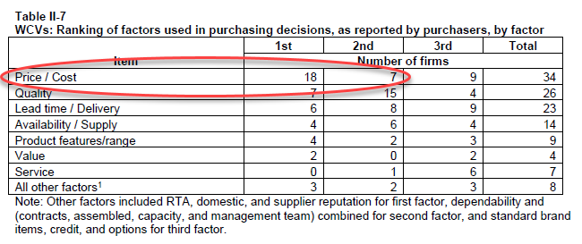
Price is the Number One Purchasing Factor
74 % of responding purchasers named price/cost as the 1st or 2nd purchasing factor
Source: Prehearing Staff Report Table II-7, p. II-17.

Slide 5
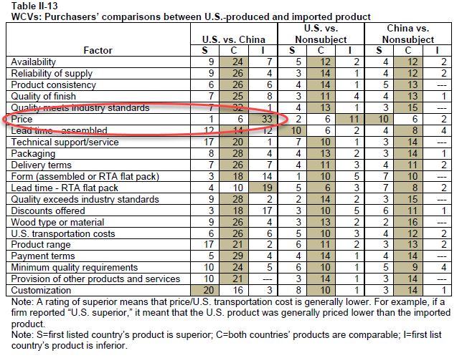
U.S. and Chinese Product Are Similar On Most Factors Except for Price
Source: Prehearing Staff Report Table II-13, p. II-23.

Slide 6
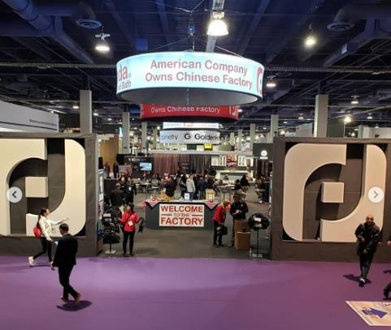
KBIS 2019
Chinese producers are targeting the US market
Notes:
Chinese producers and US importers of Chinese product are targeting the US market
This is Panda at last year’s KBIS show

Slide 7
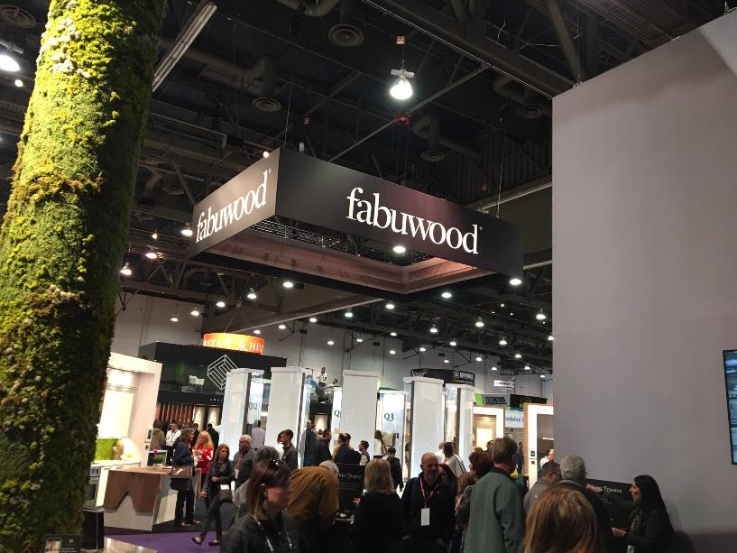
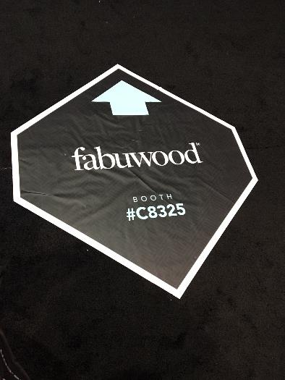
FABUWOOD
Notes:
These photos were taken last year at the 2019 Kitchen and Bath Industry Show (KBIS) in Las Vegas.
No company had a more dominant presence than Fabuwood. Literally, all roads at KBIS led to Fabuwood, and its booth shown on the right.

Slide 8
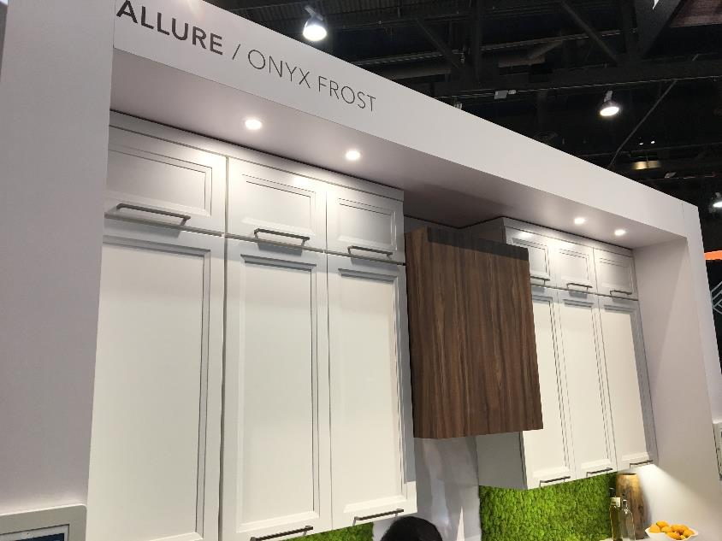
FABUWOOD
Notes:
All the latest trends, all the latest styles.
Fabuwood’s slogan on its website is “quality redefined.” It advertises its premium cabinets according to a 12-step program known as Q12 – dovetail construction, anti-warp structures, solid half-inch plywood backs, soft closing hinges and drawers, and a host of other high quality features.

Slide 9
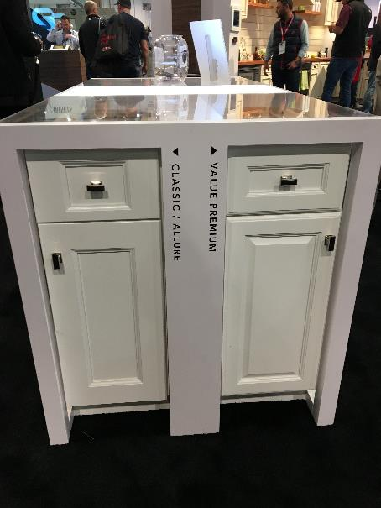
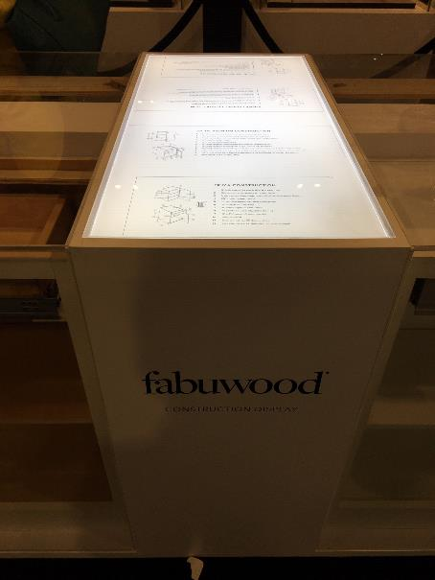
FABUWOOD
Notes:
At KBIS, Fabuwood showed multiple product lines, from entry level to premium, all with different features and styles.
According to Fabuwood, THOUSANDS of exclusive dealers across the nation sell Fabuwood cabinets.
Fabuwood also has a new one million square foot state of the art assembly facility, and proudly boasts that it is “destined for exponential growth.”

Slide 10
J&K CABINETRY
“We offer semi-custom and Ready-to Assemble (RTA) cabinets.”
J&K is the affiliated and exclusive importer for Dalian Meisen –dumping margin 262.18%
Source: https://www.jandkcabinetrychicago.com/about.

Slide 11
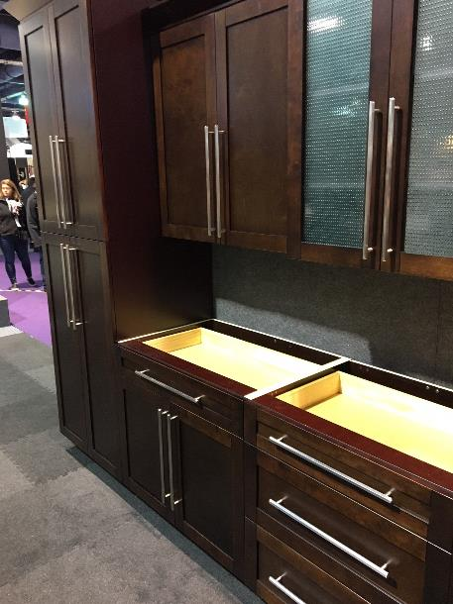
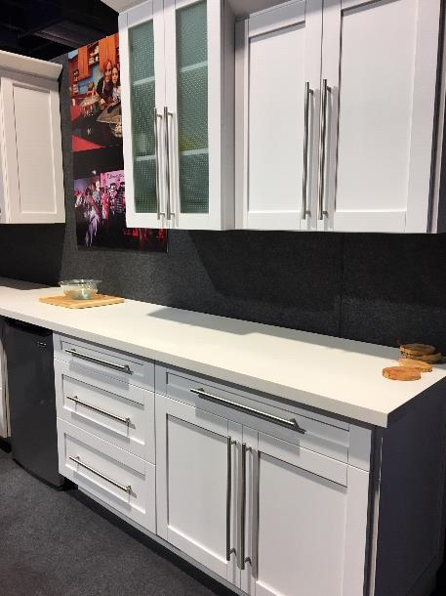
PANDA
Notes:
Their website has more than 100 photos of various cabinet installations and also features photos of their multiple integrated manufacturing operations in China.

Slide 12
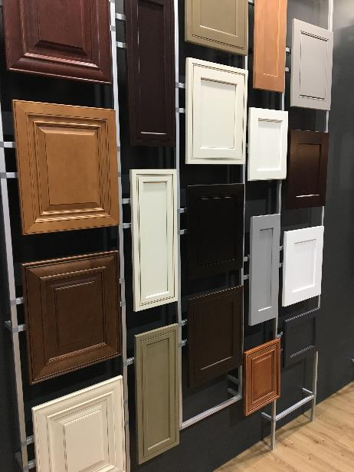
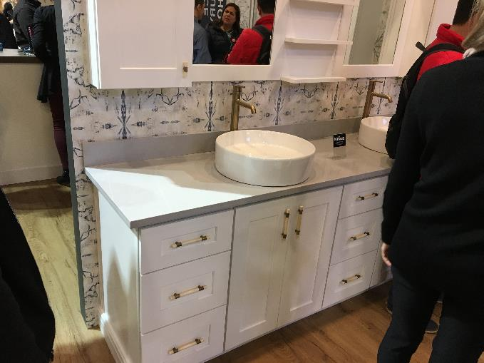
GOLDENHOME
Notes:
Goldenhome says: “The North American market is a major international market Goldenhome has particularly focused in recent years. America is now a crucial country for the global strategic layout of Goldenhome.

Slide 13
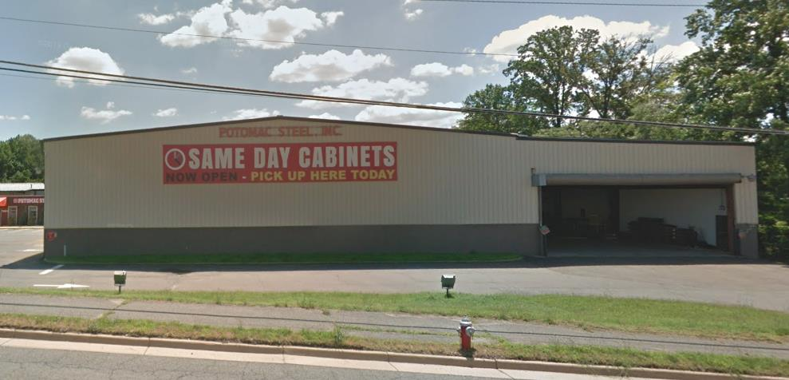
Notes:
This is Same Day Cabinets, just off 95 in Springfield – some of you may have passed it on your way to work today.

Slide 14
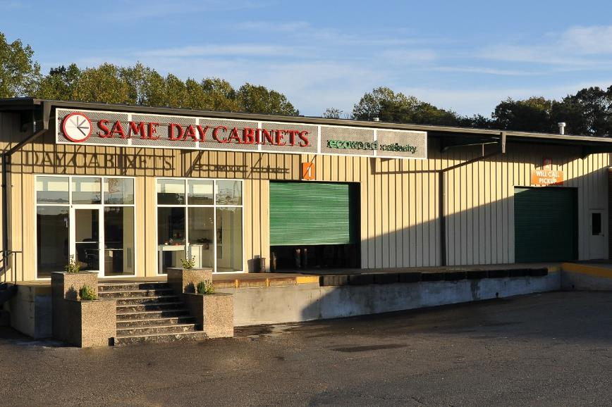
SAME DAY CABINETS / ECO WOOD
Notes:
Here is the picture of the outside of the store – which also mentions Ecowood Cabinetry

Slide 15
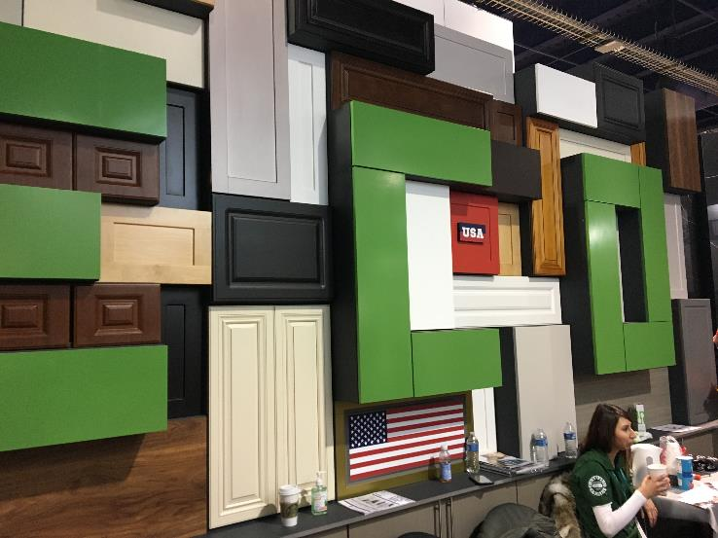
SAME DAY CABINETS/ECO WOOD
Notes:
And here is the KBIS booth for Ecowood. A variety of styles and colors, and a very large American flag featuring prominently in its display.

Slide 16
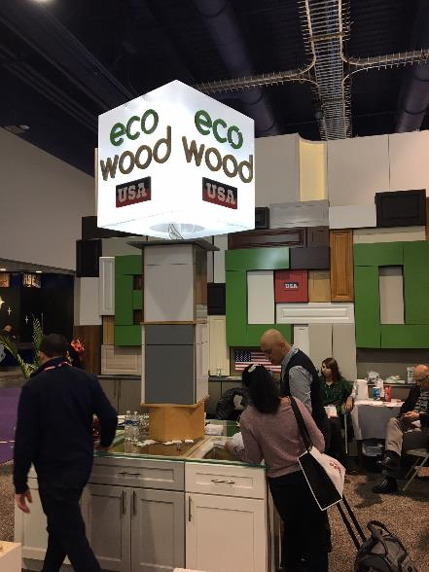
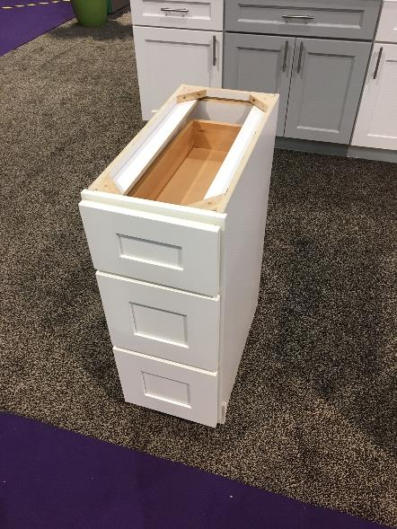
SAME DAY CABINETS/ECO WOOD
Notes:
And here again –we asked the Ecowood people at the booth last year if their cabinets were made in America. Oh no, they answered – they are all made in China.

Slide 17
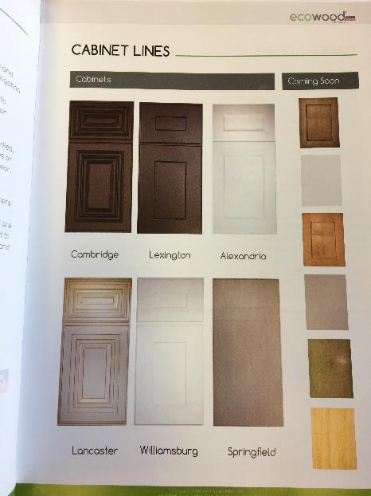
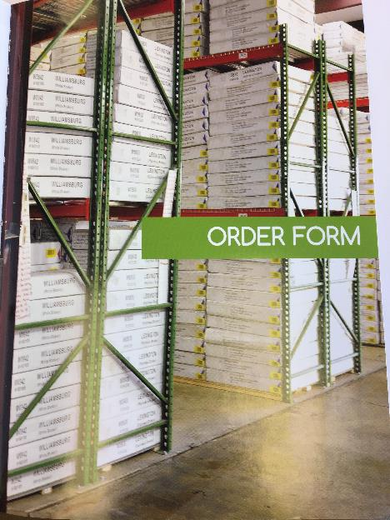
SAME DAY CABINETS/ECO WOOD
Notes:
And sure enough, while the product lines and styles all have American names – Cambridge, Lexington, Alexandria, Williamsburg, Springfield – what they are really selling is ready to assemble cabinets – dumped and subsidized – from China.
Notice the inventories
This is not just happening in Springfield and DC – but in hundreds of locations, large and small, across America. And the business model is built on a foundation of dumped and subsidized pricing.

Slide 18
Chinese and U.S. Product Compete Head-to-Head on All Cabinet and Vanity Types
Source: Prehearing Staff Report Table II-11, p. II-21.

Slide 19
RTA Flat Packs Compete Head-to-Head with Domestic Product
Source: Prehearing Staff Report Table IV-5, p. IV-12.

Slide 20
Subject Imports Grew 54% During the POI
Source: Prehearing Staff Report Table IV-2, p. IV-6.

Slide 21
The Domestic Industry Lost Market Share to Subject Imports
Source: Prehearing Staff Report Table C-1, p. C-3.

Slide 22
Chinese Product Predominantly Undersold the Domestic Product During the POI
Chinese product undersold the domestic product in 115 of 120 comparisons
Average underselling margins were very substantial
Source: Prehearing Staff Report Table V-12, p. V-28.

Slide 23
Purchasers confirmed they purchased Chinese instead of US product because of lower price
Purchased Chinese product instead of domestic since 2016? | 59% (24 out of 41)
Chinese product lower priced? | 92% (23 out of 25)
Price was a primary reason for purchasing Chinese product? (Total $ amount BPI) | 75% (18 out of 24)
Source: Prehearing Staff Report Table V-14.

Slide 24
Preliminary Margins
Antidumping Duty Margins
The Ancientree Cabinet Co., Ltd. | 4.49 percent
300 Chinese producers | 39.25 percent
Foremost Worldwide Company Limited | 80.96 percent
Dalian Meisen Woodworking Co., Ltd. | 262.18 percent
China-wide entity | 262.18 percent
Countervailing Duty Margins
Countervailing duty margins | Between 10.97 and 229.24 percent
Source: Prehearing Staff Report at Table I-1, p. I-4 and Appendix D.
Notes:
CVD margins increased after additional preliminary subsidy findings

Slide 25
All Major Trade and Financial Indicators Declined During the POI
Indicator | Change 2016-2018
Production
Capacity Utilization
U.S. Shipment Quantity
Net Sales Quantity
Gross Profit
Operating Income
Net Income
Capital Expenditures
Source: Prehearing Staff Report Table C-1, p. C-3.

Slide 26
The Domestic Industry’s Financial Performance Has Declined
Demand for wooden cabinets and vanities increased during the POI
Despite strong demand, dumped and subsidized Chinese imports deprived the domestic industry of increased shipments
The financial performance of the industry suffered and U.S. producers have shuttered facilities
Operating income and margins declined significantly

Slide 27
Negative Effects Highlighted in Public Financial Statements
“We also face competition with respect to some of our products from competitors in countries with lower regulatory, safety, environmental, and other costs, such as China. These competitors may also benefit from certain local government subsidies or other incentives that are not available to us.”
“We also face increasing pressure from imported ‘flat pack’ cabinets.”

Slide 28
Actual Negative Effects Caused by Subject Imports
MasterBrand
American Woodmark
U.S. manufacturing operations have been discontinued, closed or idled
Canceled participation in recent trade shows
Capital investment spending is down
Unable to invest in R&D or other strategic initiatives
Dumped imports impacted their decision not to invest in a next generation plant
Forced to make investments in a lower cost acquisition

Slide 29
Actual Negative Effects Caused by Subject Imports
ACPI
Kitchen Kompact
2016 expansion at Mt. Union, PA facility did not meet anticipated growth levels, particularly in multifamily and distributor channels
Declining sales has not allowed investments in new equipment and machinery
Wellborn
Showplace
Did not proceed with cabinet production expansion due to slowing sales and significant margin erosion
Lost showroom space to Chinese product lines. Must now heavily discount its products and include, as standard, options and features that were once charged a premium
Operating profit declined in part by pricing concessions, due to the impact of low priced import product in the market. The profit erosion is impacting the overall return on capital of the business

Slide 30
Chinese Imports Threaten the Domestic Industry with Further Injury
Declining profitability and loss of market share have rendered the domestic industry vulnerable
The subsidies received by the Chinese wooden cabinet and vanity industry encourage exports
The Chinese industry has large amounts of available capacity, is adding capacity and can expand production
Chinese imports undersell the domestic product consistently and by significant margins
Competition with Chinese imports has harmed and discouraged investments in new equipment and technology by the domestic industry

Slide 31
U.S. importers’ inventories of Chinese product increased by 30 percent during the POI
Source: Prehearing Staff Report Table VII-8, p. VII-18; and Table IV-2, p. IV-6.

Slide 32
All Major Trade and Financial Indicators Declined During the POI
Indicator | Change 2016-2018
Production
Capacity Utilization
U.S. Shipment Quantity
Net Sales Quantity
Gross Profit
Operating Income
Net Income
Capital Expenditures
Source: Prehearing Staff Report Table C-1, p. C-3.

Slide 34
Chinese Imports Have Been Significantly Impacted by the Filing of Trade Cases
Source: USITC Dataweb, HTS 9403.40.9060.

Slide 35
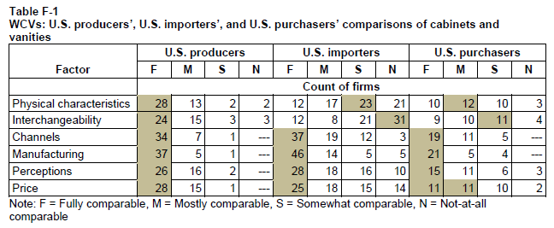
Cabinets and Vanities are Fully/Mostly Comparable
Source: Prehearing Staff Report at Table F-1, p. F-3.

Slide 36
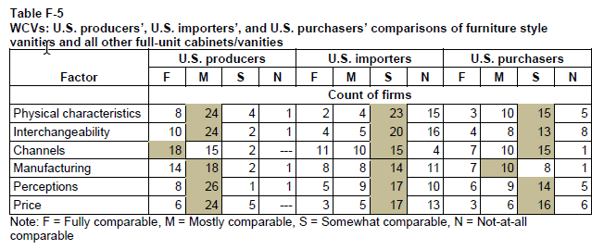
Furniture Style Vanities are Fully/Mostly Comparable
Source: Prehearing Staff Report at Table F-5, p. F-21.

Slide 37
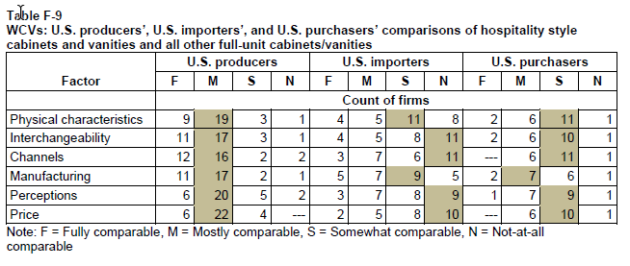
Hospitality Style Cabinets and Vanities are Fully/Mostly Comparable
Source: Prehearing Staff Report at Table F-9, p. F-38.

Slide 38
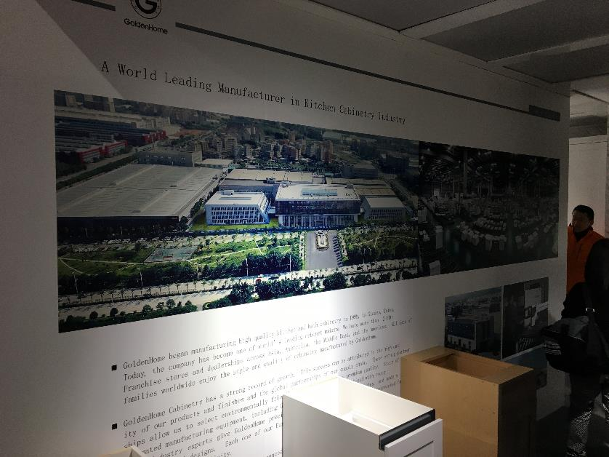
GOLDENHOME
Notes:
Goldenhome also is, as this sign says, “a world leading manufacturer in kitchen cabinetry industry
It began in 1999 and has more than 2000 franchise stores and dealerships worldwide. In 2017, Goldenhome ahd grand openings for its warehouses on both US coasts – one in Los Angeles, and one in Cranbury, NJ

Slide 39
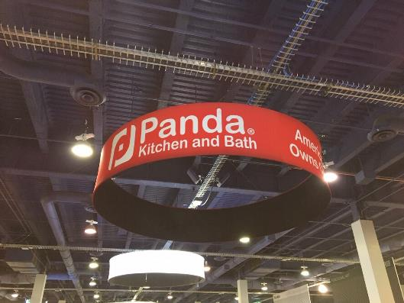
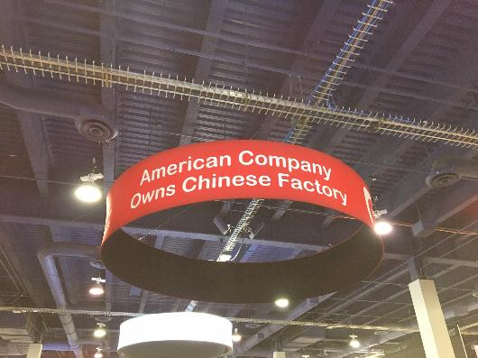
PANDA
Notes:
Front and center in one of the exhibit halls was Panda – it was impossible to miss
Panda was established in the 1980s in China, and in the US in 2000. In 2008, Panda franchised the Panda Kitchen and Bath concept. They are all over the DC metro area, with at least 27 store locations and 500,000 square feet of warehouse space

Slide 40
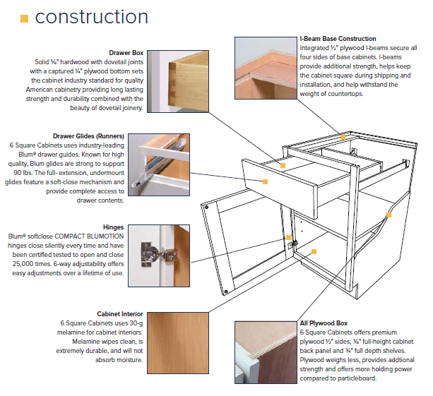
6 SQUARE CABINETS
Sides: 1/2-inch plywood; never particleboard
Back Panel: 3/8-inch plywood; never particleboard
Faceframe: solid hardwood
Door Construction: Solid hardwood stiles & rails
Wood Species: maple, cherry, oak, birch
Drawer Box: 5/8-inch hardwood; dovetail joints
Interior: Easy-to-clean Melamine
Drawer Glides: Blum® soft-close, full-extension undermount
Hinges: Blum® soft-close, steel, 6-way adjustable
Shelves: full-depth plywood; never particleboard
Customization: Built-to-fit with option to customize
Assembly: Factory-assembled
Shipping: Free on most orders*
Warranty: Limited Lifetime warranty
Source: https://www.6squarecabinets.com/construction/.

Slide 41
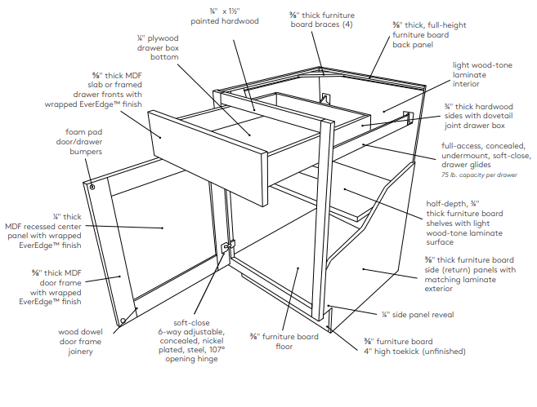
CLIQSTUDIOS
Source: https://www.cliqstudios.com/construction-specifications/

Slide 42
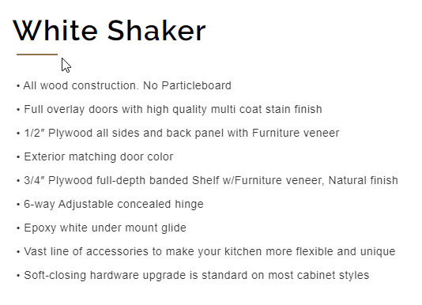
ANAHEIM KITCHEN & BATH
Source: https://kovillecabinetry.com/white-shaker/

