Slide 1
Wooden Cabinets and Vanities from China
Inv. No. 701-TA 620 and 731-TA-1445 (Final)
February 20, 2020
On Behalf of
The American Kitchen Cabinet Alliance
International
Economic Research
LLC
Dr. Seth T. Kaplan
skaplan@ier-llc.com
(202) 403-9439

Slide 2
Overview
Conditions of Competition
Injury
Threat

Slide 3
Overview
Conditions of Competition
Injury
Threat
Conditions of Competition

Slide 4
Conditions of Competition
Growth of subject imports
Head-to-head competition
Price-based competition
Cyclical demand
Subject imports moved up the value chain

Slide 5
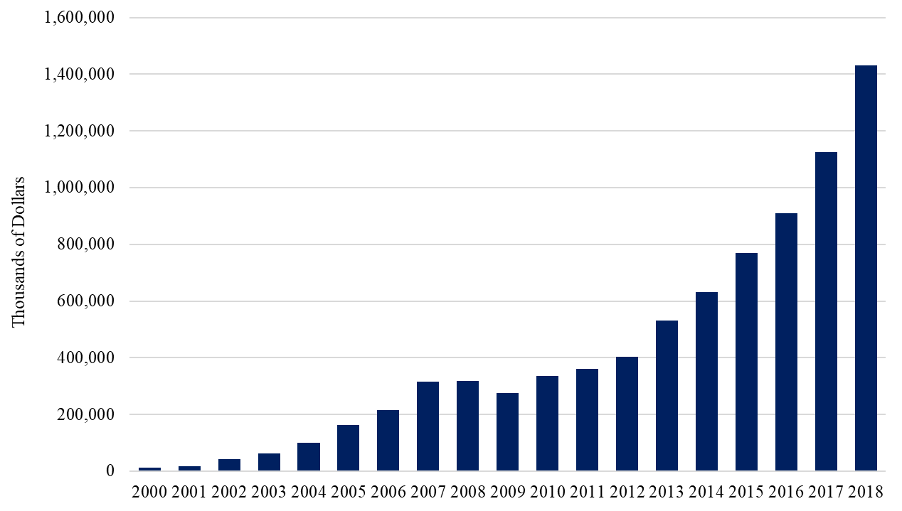
Value of Subject Imports
C of C
Growth
Subject Imports of Full Units
Source: USITC Dataweb

Slide 6
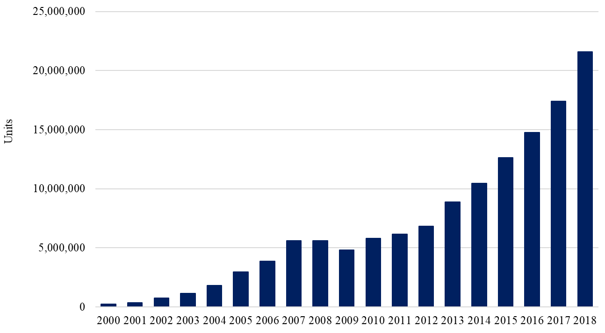
Volume of Subject Imports
C of C
Growth
Source: USITC Dataweb. Assumes AUVs increased 1 percent per year from 2000 to 2016

Slide 7
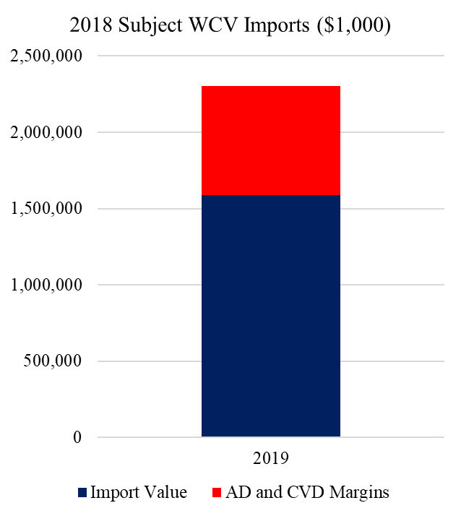
Import Value
C of C
Growth
Value level and share is understated
Value fails to account for AD/CVD margins
Import value is at a different level of trade
Source: SR at C-3, https://enforcement.trade.gov/download/factsheets/factsheet-prc-wooden-cabinets-vanities-ad-cvd-initiation-032719.pdf

Slide 8
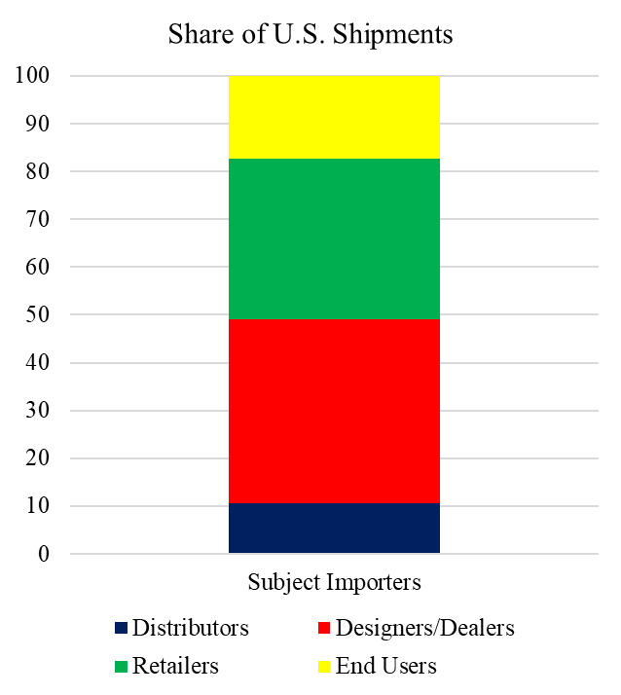
Channels of Distribution
C of C
Head-to-Head
Imports are significant in all channels
U.S. producers ship similar shares to each channel
Source: SR at II-3

Slide 9

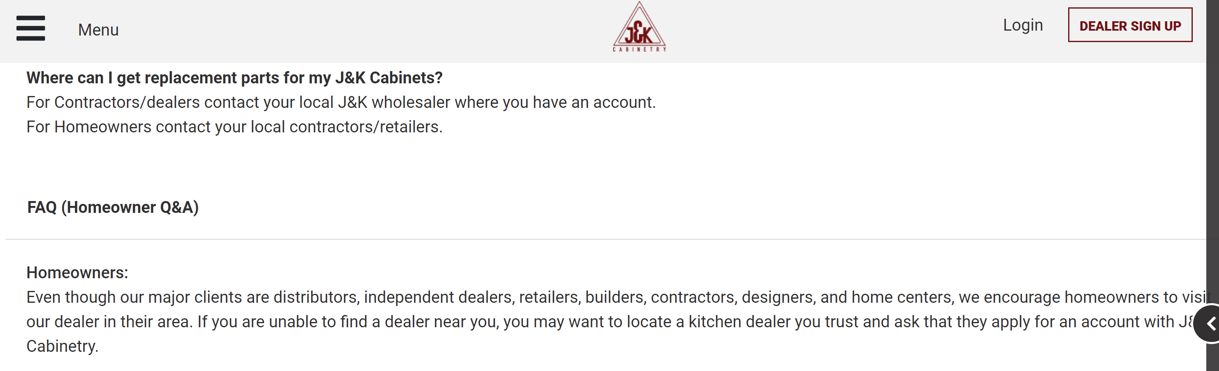
Subject Imports Compete in
All Channels of Distribution
C of C
Head-to-Head
“Our major clients are distributors, independent dealers, retailers, builders, contractors, designers, and home centers.”
Sources: J&K Homeowner Q&A. https://jandkcabinetry.com/support/. Accessed on 3/21/2019

Slide 10
Specifications
C of C
Head-to-Head

Slide 11





Styles
C of C
Head-to-Head
Lily Ann Colorado White Shaker
Fabuwood Allure Galaxy Frost
Anaheim White Shaker
MasterBrand Aristokraft Korbett
KountryWood Jamestown
Subject Imported
Domestic

Slide 12
Premium Features
C of C
Head-to-Head
Soft-close drawers and doors
Dovetail drawer construction
Plywood construction
Finished interiors

Slide 13
Premium Features
C of C
Head-to-Head
Source: Petitioner Pre-hearing Economic Submission Attachment C

Slide 14
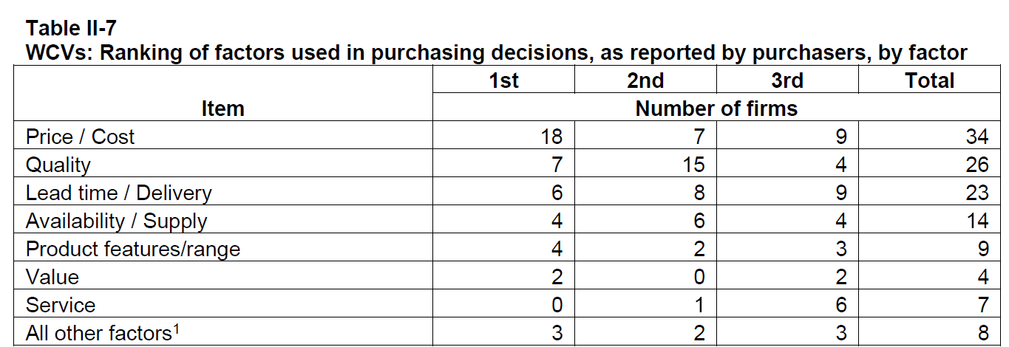
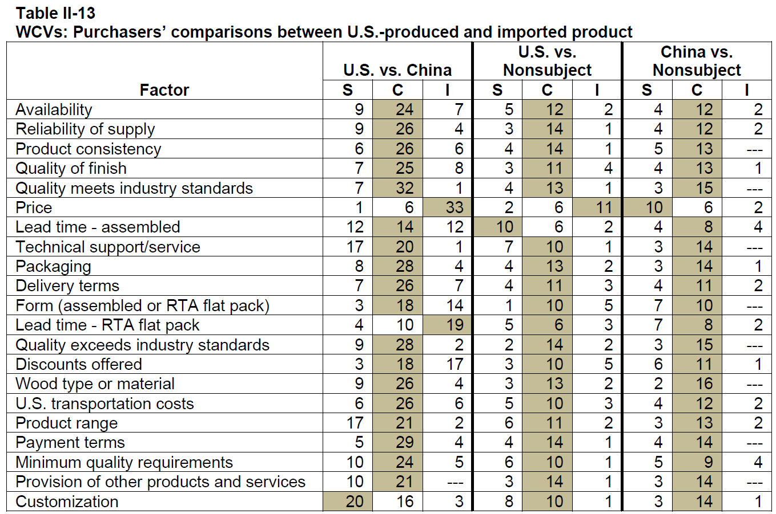
Price is the Most Important Purchasing Factor
C of C
Price

Slide 15
Commission Data Shows a Vast
Overlap of Domestic and
Subject Price Points
C of C
Price
Subject Importers
U.S. Producers
Low
High
Price
See CSR at VI-15 and Petitioner Pre-Hearing Economic Submission at pp. 33

Slide 16
Subject Imports Go to Market on Price in Every Channel of Distribution
C of C
Head-to-Head
Distributors
Designers/Dealers
Retailers
End Users

Slide 17

Distributors
C of C
Price

Slide 18



Designers/Dealers
C of C
Price
“We make building a luxury kitchen affordable”

Slide 19


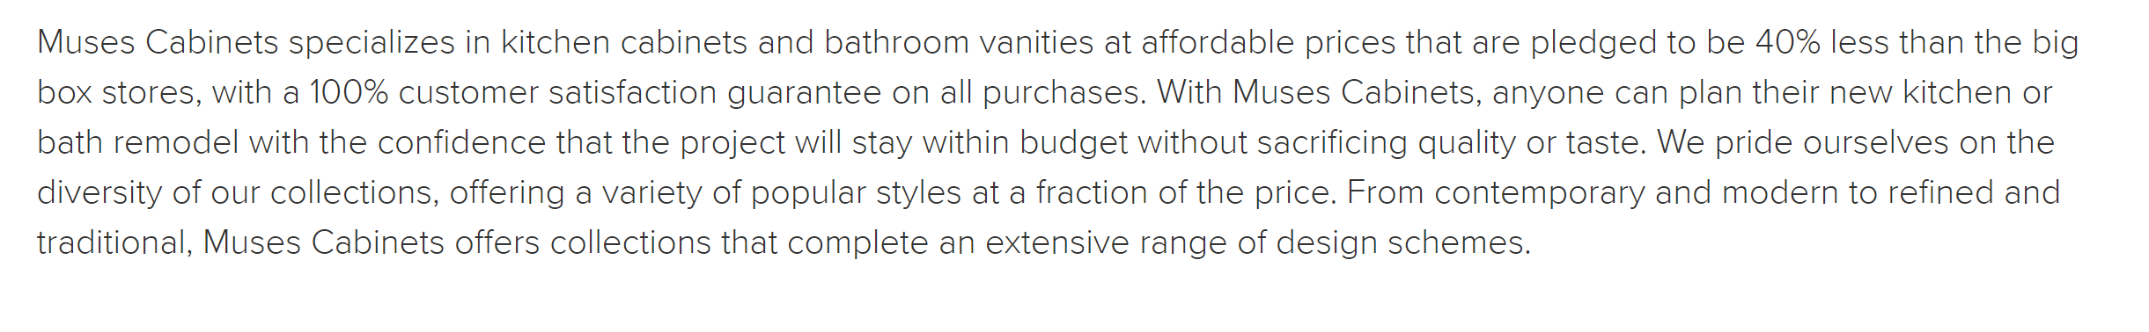


Retailers
C of C
Price
“Half the Price of Big Box Stores”
“40% less than the big box stores”
“Save 30% - 50% when comparing to the big box stores
“20-40% less than the big box stores”

Slide 20

End Users
C of C
Price
“high quality products at economical and affordable prices”
“Our target clients are…contractors, builders…”

Slide 21
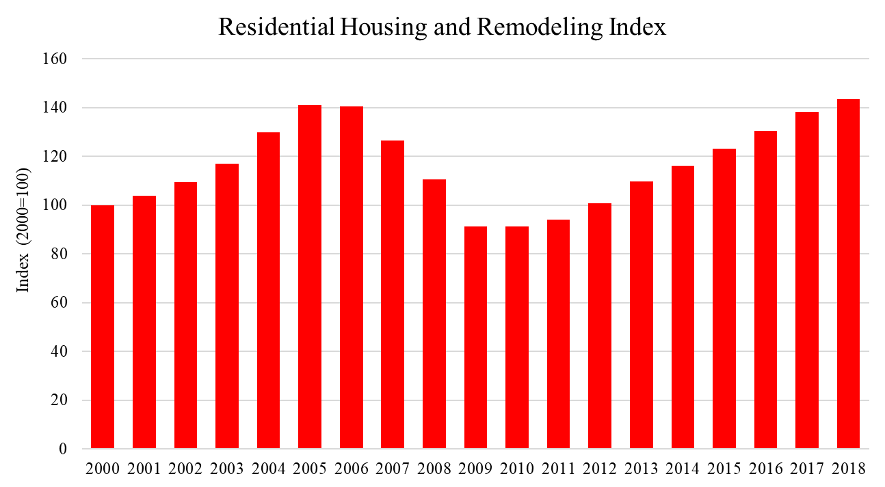
Demand is Cyclical
C of C
Cyclical
Sources: U.S. Census Bureau and U.S. Department of Housing and Urban Development, Housing Starts: Total: New Privately Owned Housing Units Started [HOUSTNSA], retrieved from FRED, Federal Reserve Bank of St. Louis; https://fred.stlouisfed.org/series/HOUSTNSA, March 22, 2019.
U.S. Census Bureau, Retail Sales: Building Material and Supplies Dealers [MRTSSM4441USN], retrieved from FRED, Federal Reserve Bank of St. Louis; https://fred.stlouisfed.org/series/MRTSSM4441USN, March 23, 2019. Henceforth – FRED Housing Starts and Building Materials.

Slide 22
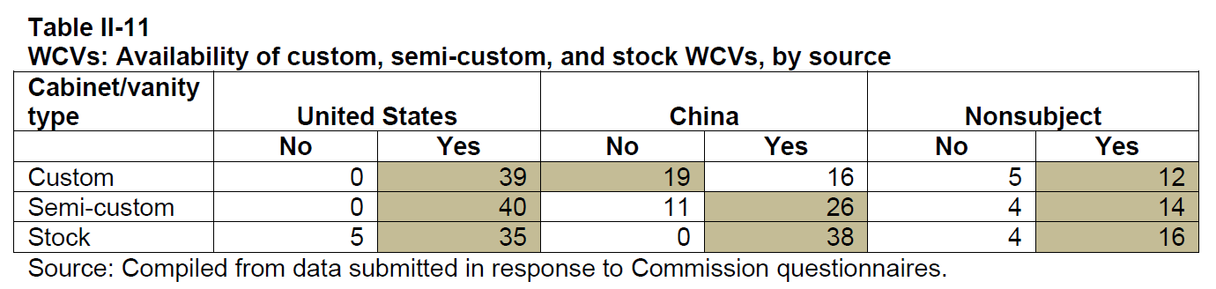
Subject Imports Moved Up the Value Chain
C of C
Value Chain

Slide 23
Overview
Conditions of Competition
Injury
Threat
Injury

Slide 24
Trends Analysis
Injury
Trends
Volume
Price
Effects

Slide 25
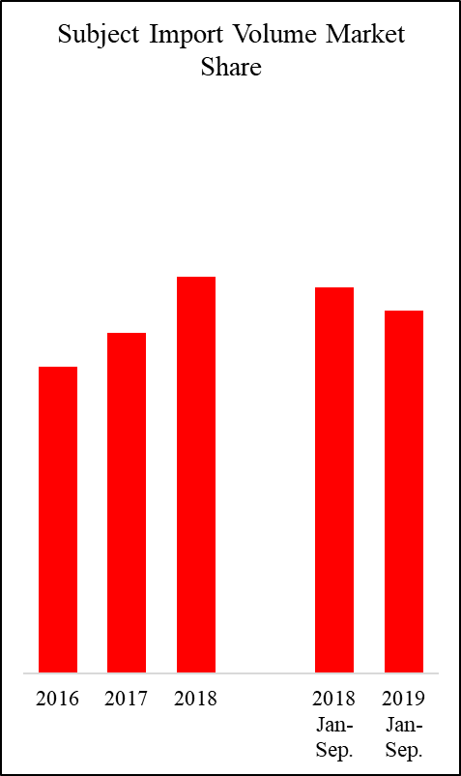
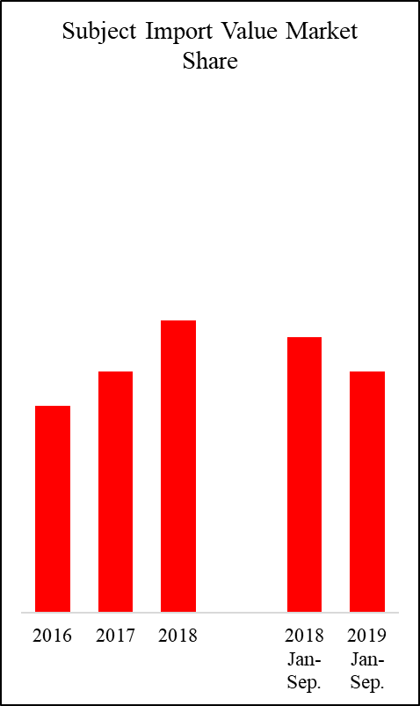
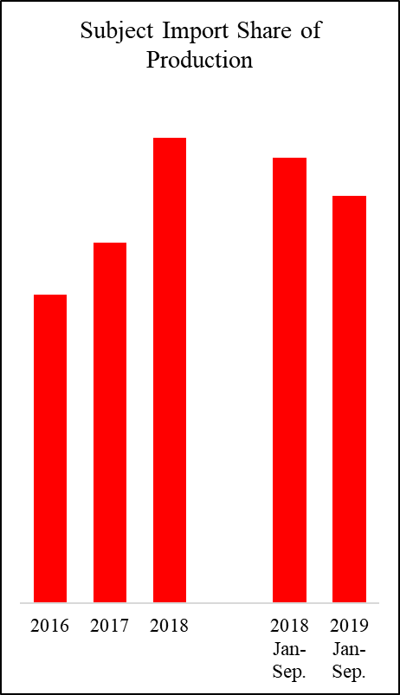
Volume
Injury
Volume

Slide 26
Price
Injury
Trends
Imports undersell and suppress prices
  Underselling in 115/120 instances
  Kitchen-to-kitchen comparisons confirm underselling
  Imports are “superior” on price
  AUVs show underselling
  There is a cost-price squeeze

Slide 27
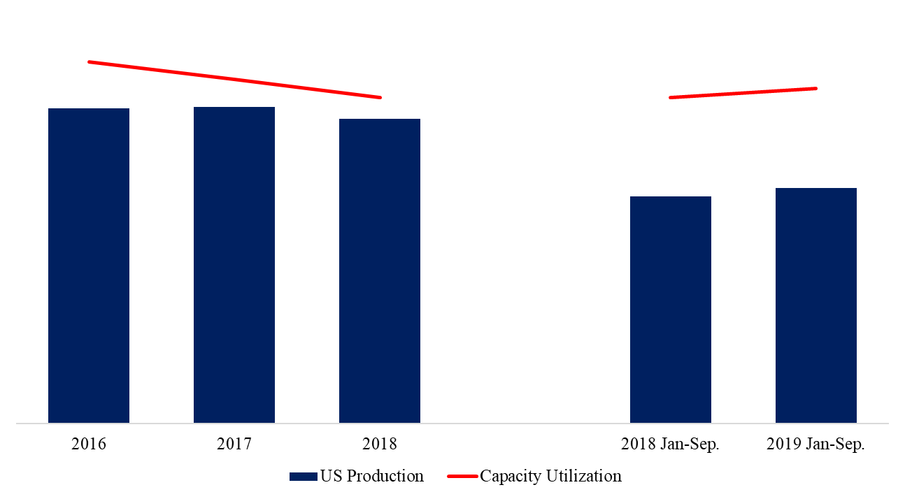
Production and Capacity
Utilization Decreased in a Rising Market
Injury
Impact

Slide 28
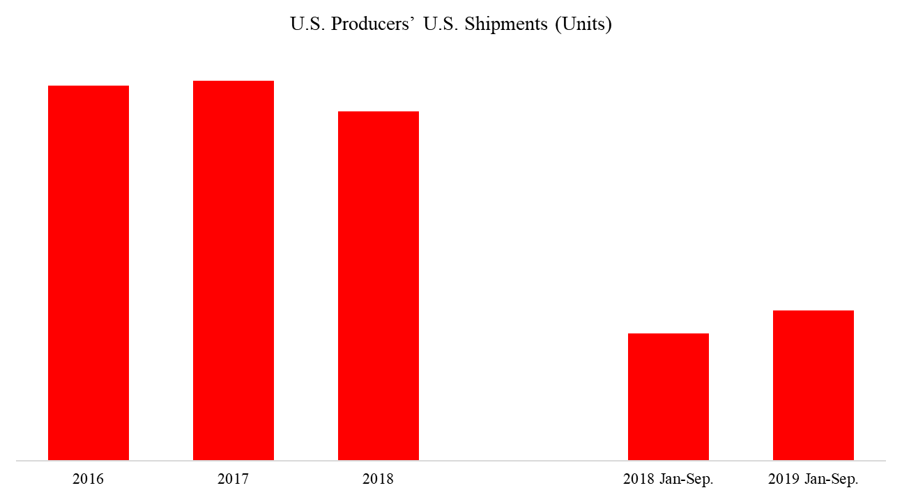
Shipments Decreased in a
Rising Market
Injury
Impact

Slide 29
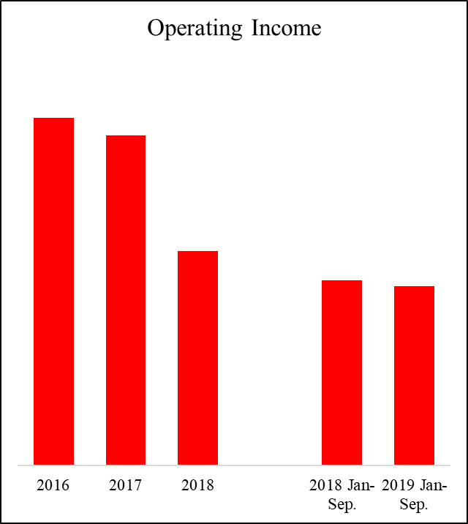
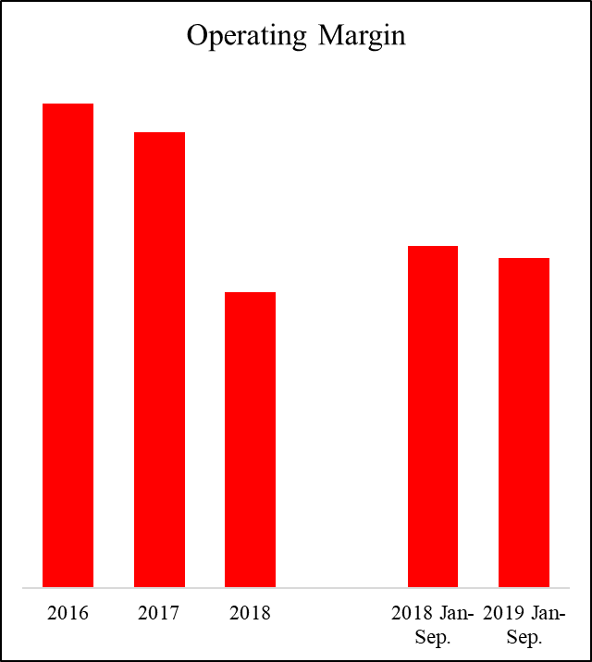
Operating Income and
Operating Margin Declined in a Rising Market
Injury
Impact

Slide 30
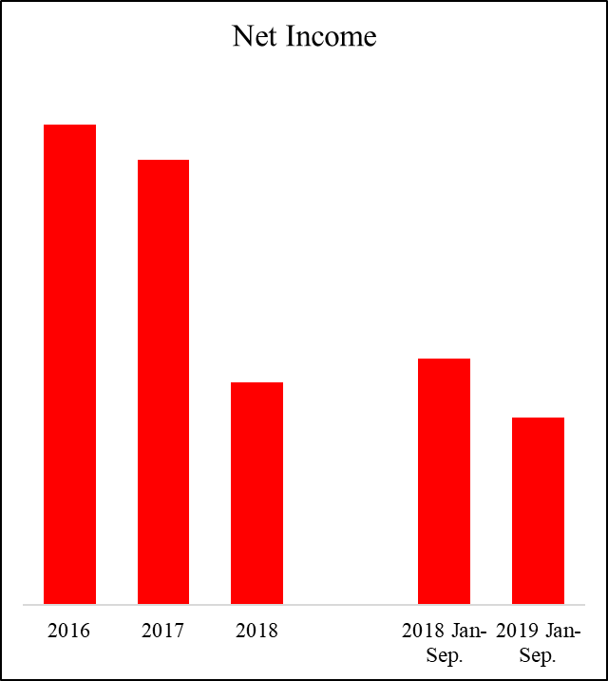
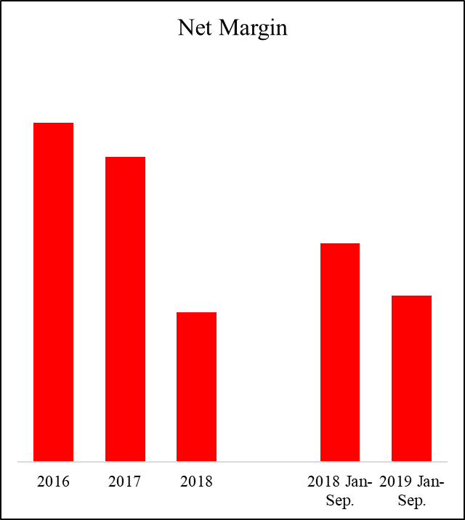
Net Income and
Net Margin Declined in a Rising Market
Injury
Impact

Slide 31
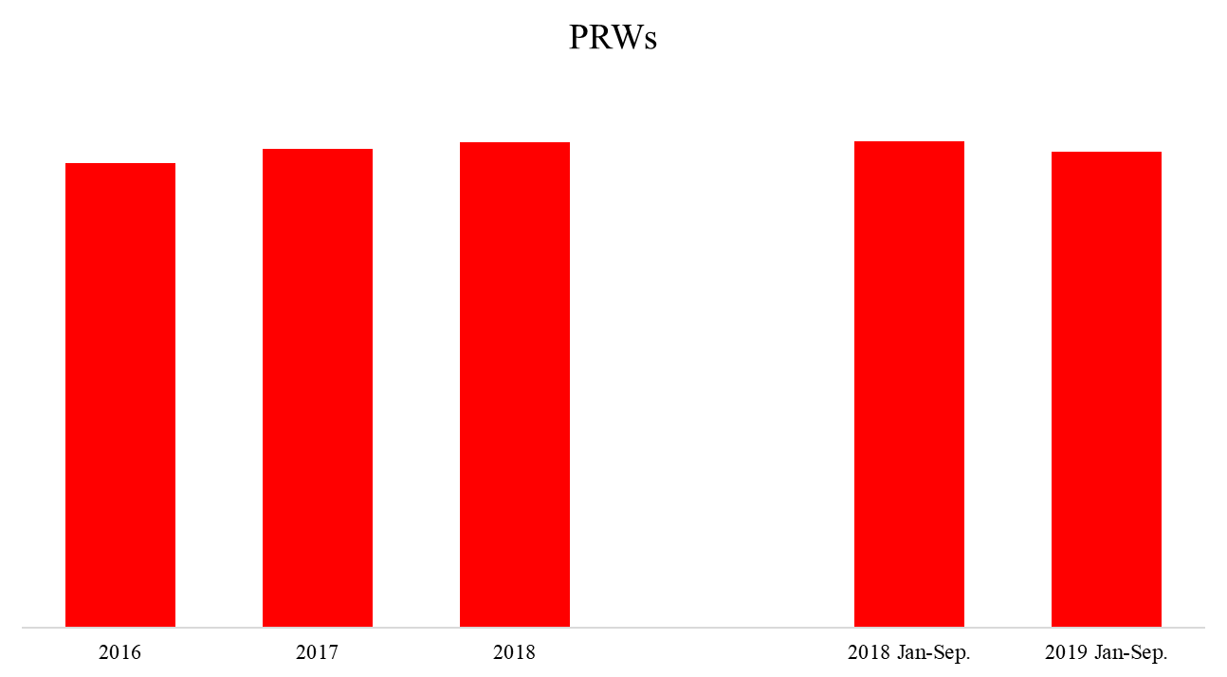
Employment was Flat in a Rising Market
Injury
Impact

Slide 32
Changes in Operation and Effects on Investment
Injury
Impact
Production curtailments and facility closures
Low returns on investment in new and existing facilities
Postponement and cancellation of planned investments

Slide 33
Financial Markets Reflect
Injury to Domestic Producers
Injury
Cycle
Publicly traded firms identify imports as a risk factor in SEC filings
Wall Street analysts…
  stated that Chinese imports harmed the industry
  downgraded industry stocks due to imports
  upgraded stocks due to the affirmative preliminary determination
  praised Masco’s sale of its cabinets division due to future import risk

Slide 34
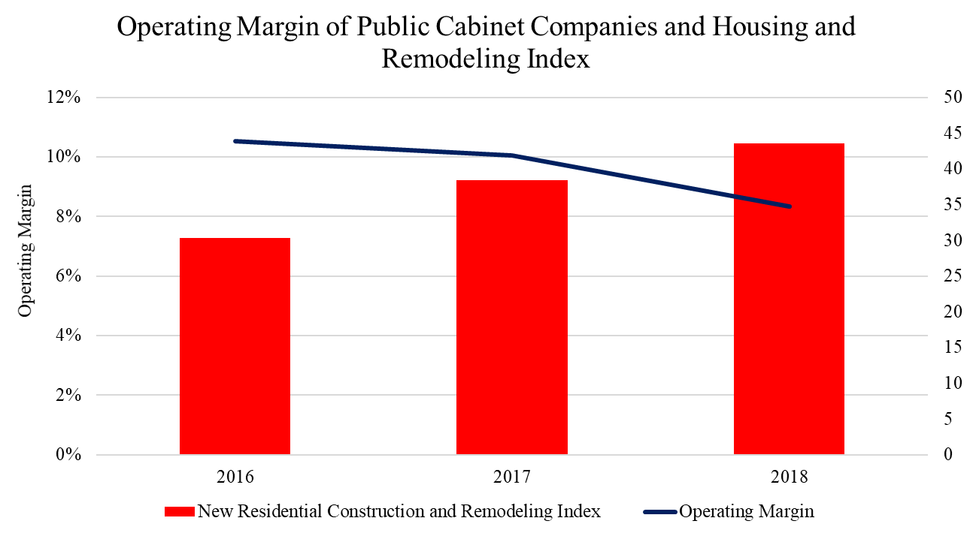
The Industry is Injured in the
Context of the Business Cycle
Injury
Cycle
Source: MASCO, American Woodmark and Fortunebrands 10-K Filings. FRED Housing Starts and Building Materials.

Slide 35
“Natural Experiment”
Injury
Interim
Pre-AD/CVD duty import AUVs actually fell in the interim period from $63 to $60
Import volumes did not decline until August 2020 at the end of the interim period
Massive subject interim inventory overhang at pre-AD/CVD duty import prices

Slide 36
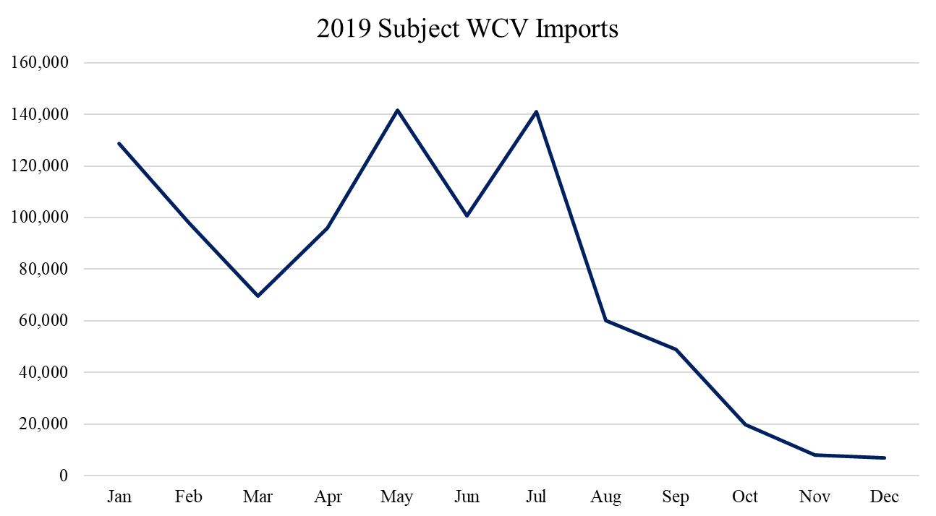
2019 Imports
Injury
Interim
Source: USITC Dataweb

Slide 37
Overview
Conditions of Competition
Injury
Threat
Threat

Slide 38
Subject Imports Threaten
Further Material Injury to the U.S. Industry
Threat
Threat Factors
Countervailing Subsidies | ✓
Unused Production Capacity | ✓
Import Volumes and Market Penetration | ✓
Price Suppression and Depression | ✓
Inventories | ✓
Negative effects on domestic industry | ✓
Other adverse trends | ✓
Source: Section 771(7)(B) of the Tariff Act of 1930 (19 U.S.C. § 1677(7)(B))

Slide 39
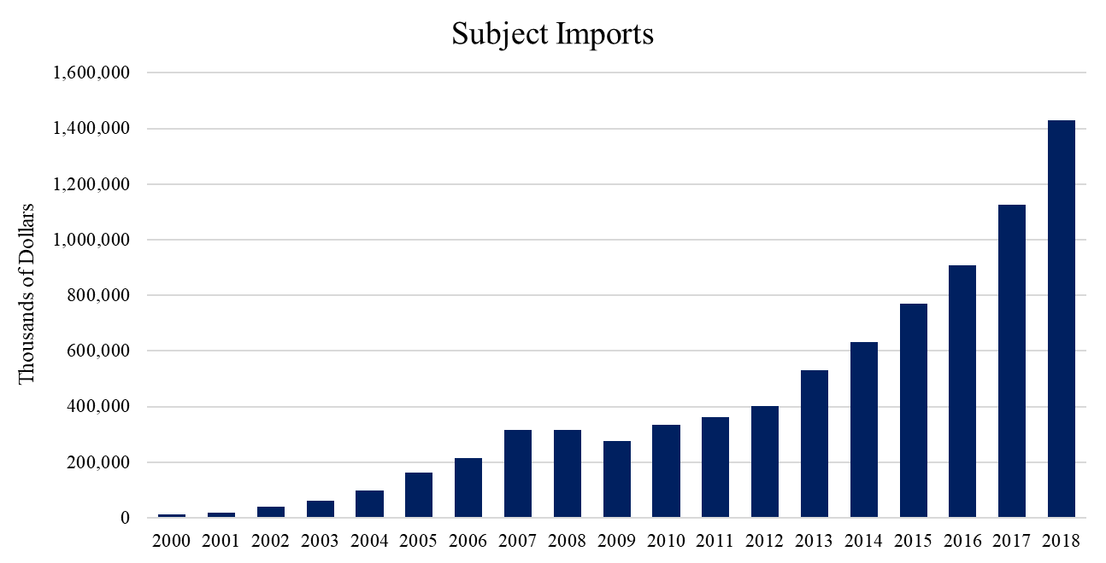
Subject Imports Threaten Further Material Injury to the U.S. Industry
Threat
Sources: USITC Dataweb

Slide 40
Supplementary Slides

Slide 41
But For Unfairly Traded
Subject Imports the Domestic Industry
Would be Materially Better off
Subject imports have a large market share
Commerce found high dumping and subsidy margins
Demand for WCVs is inelastic
There is a high substitution elasticity between domestically produced and subject imported WCVs
The market is competitive based on price

